Slide 1
Adoption Center presentation
By gary davis

Slide 2
goals
To provide recommendations on how to reduce time for animals in the center before adoption
To answer the question concerning cats and dogs being in the center in relation to age
To look at ways to manage staff more effectively during peak times

Slide 3
content
Technical process
Project proposal
Hypotheses
Results
Visualizations
Conclusions and results
Recommendations
Bonus data analysis

Slide 4
Technical process
Downloaded a live dataset on 6/6/2021
Merged two dataset
Manipulated data types, columns and added additional columns
Ran T-Test to test hypotheses
Created visualizations to highlight data and support results

Slide 5
Project Proposal
Download data from https://data.world/siyeh/austin-animal-center-live-data
All data types were objects
Converted a several columns into datetime and integers
Created new columns as float64 to complete calculations

Slide 6
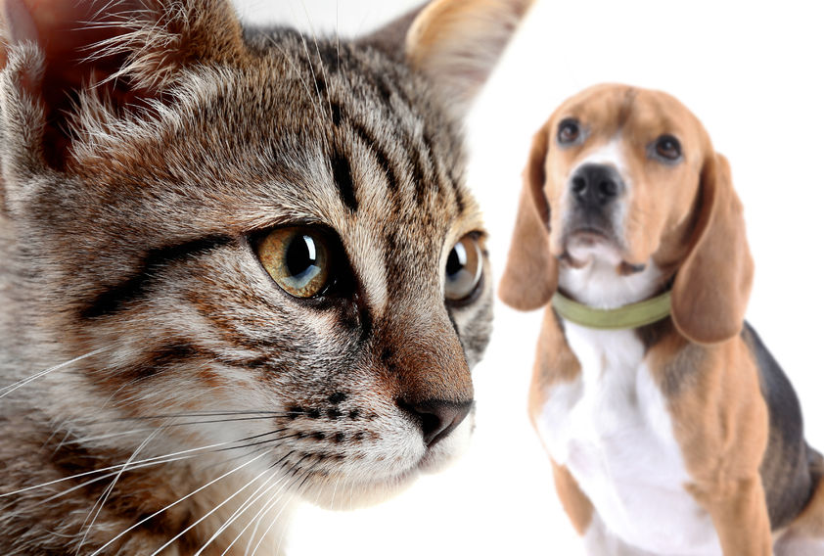
Hypotheses
There is no significant difference of time that cats are in the center over dogs before adoption
There is no significant difference of time that cats are in the center over dogs before adoption where age is a factor

Slide 7
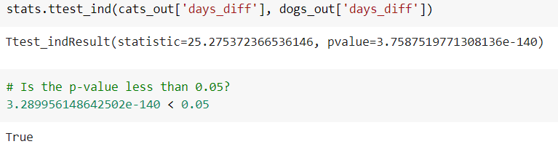
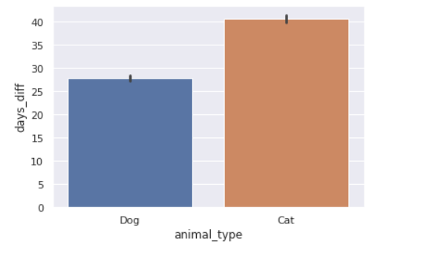
Results

Slide 8
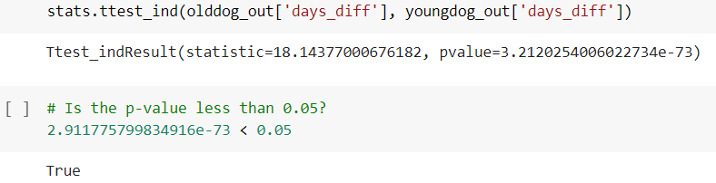
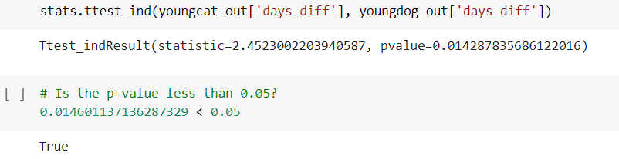
results

Slide 9
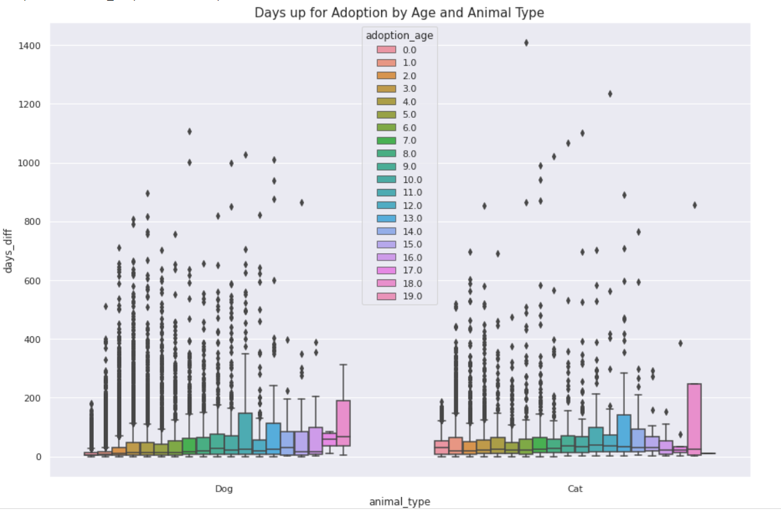
visualization

Slide 10
Conclusion and results
Cats stay in the center longer than dogs before adoption
The age of a dog does effect the length of time before adoption
Puppies (18 months or younger) have a greater chance to be adopted than a dog
The age of a cat doesn’t greatly effect the length of time before adoption

Slide 11
recommendations
Promote older dogs over puppies on a regular basis
Have cat adoption specials for cats more often than dogs
Do further analysis on animal breed and adoption length
Do further analysis on animal breed and age combined

Slide 12
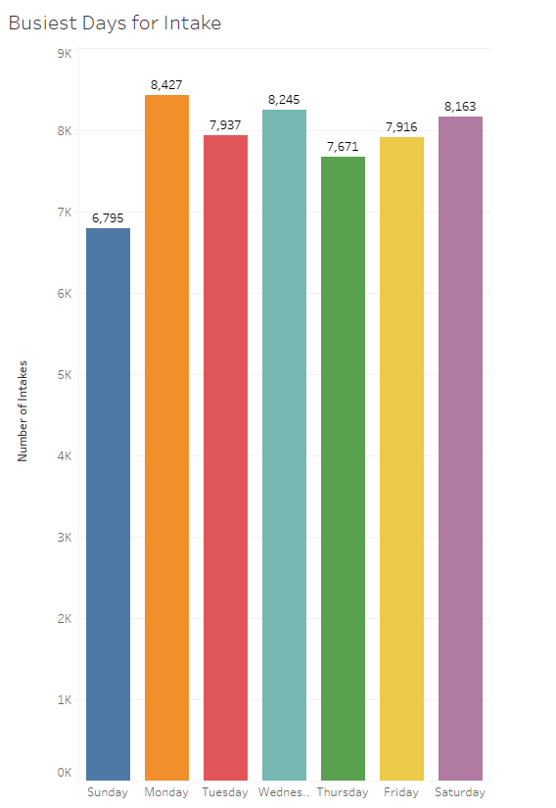
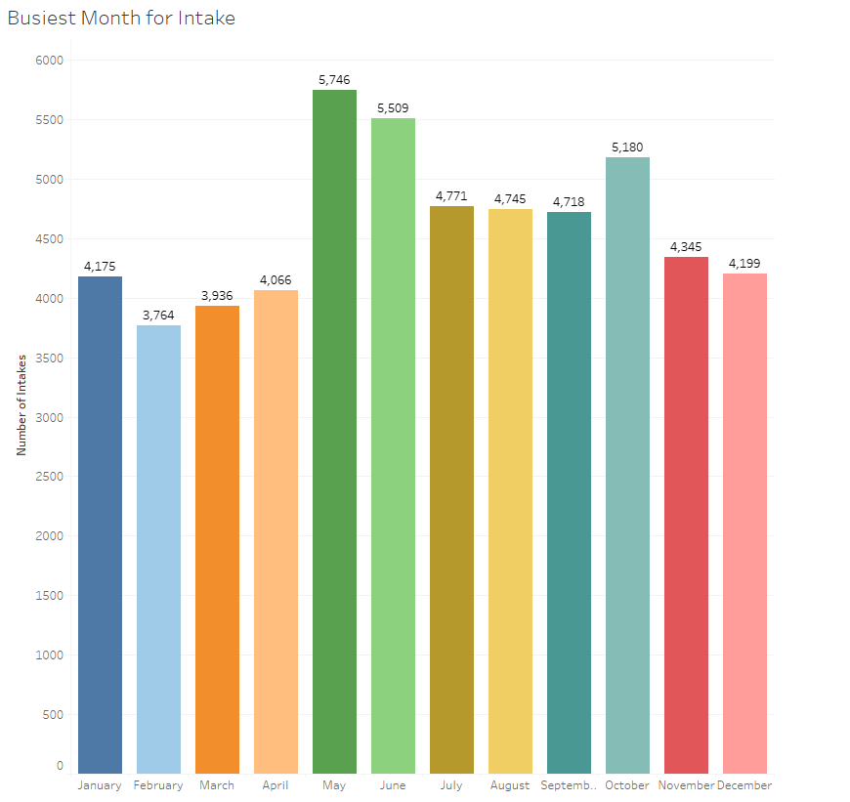
Bonus data analysis

Slide 13
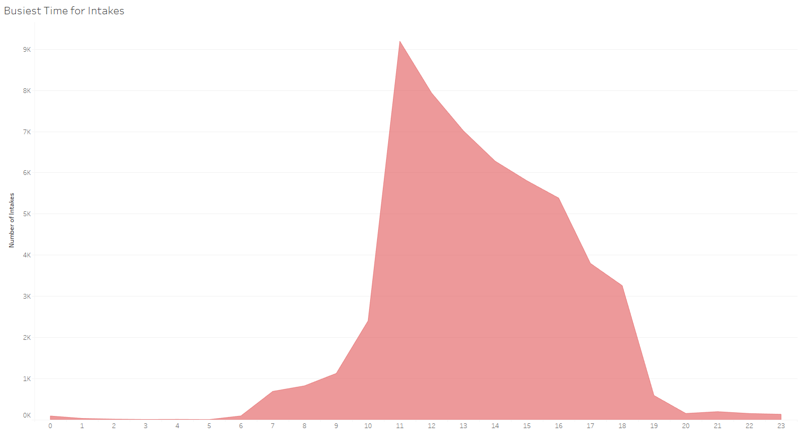
Bonus Data Analysis

Slide 14
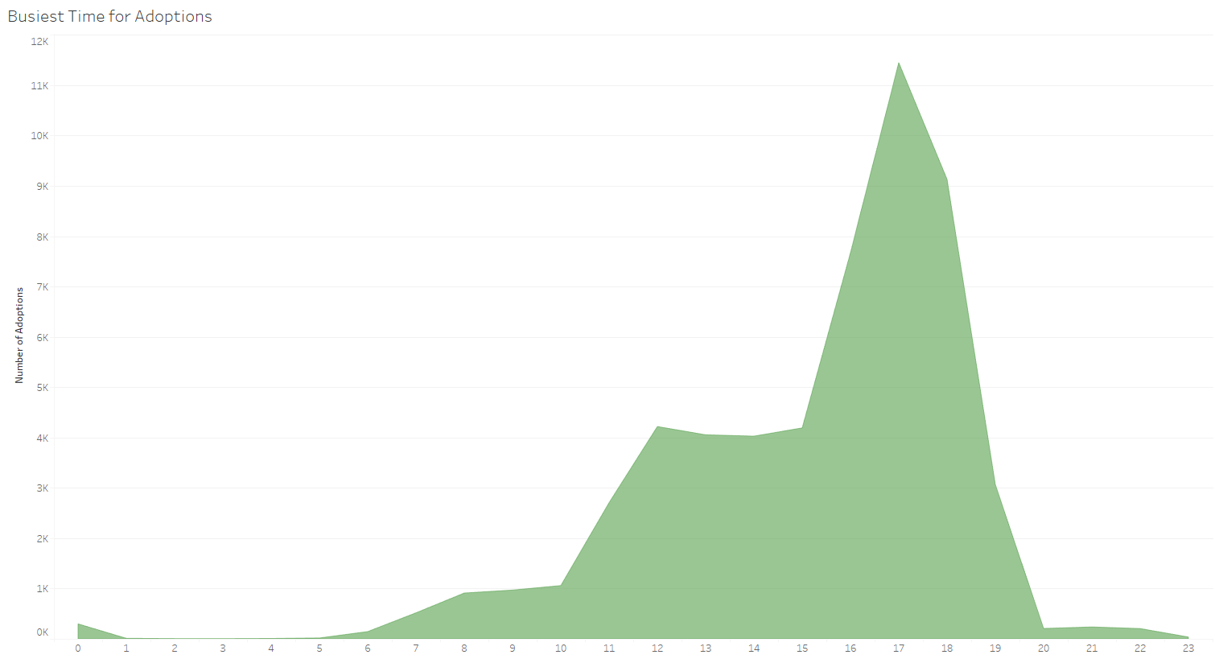
Bonus Data Analysis

